Slide 1



UNIT 4
LESSON 14
Q for a question
Part 4

Slide 2
Canada is the largest country in the world.
Canada stretches from the Atlantic Ocean in the west to the Pacific Ocean in the east.
Canada is densely populated.
It is larger than the USA and its population is nine times larger.
Although it has a low standard of living, it attracts people from all over the world.
Most people live in the northern part of Canada.
Eskimos are sometimes called Inuits but they find that name offensive.
The official languages in Canada are English and Spanish.
The Niagara Falls are located on the American side.
People go to the snowy South to experience a natural light show called the Southern Lights.

Slide 3
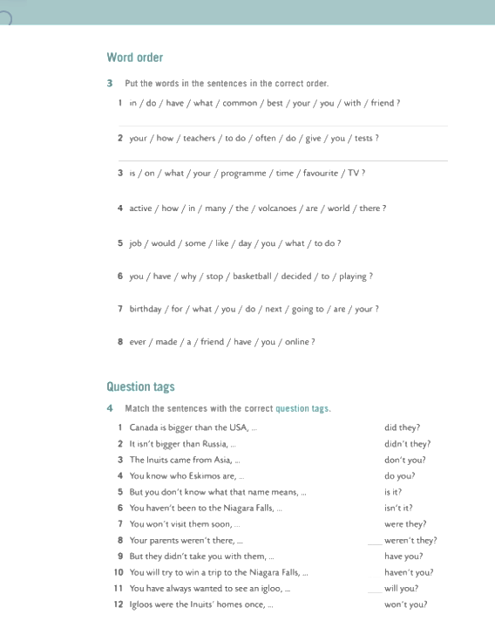
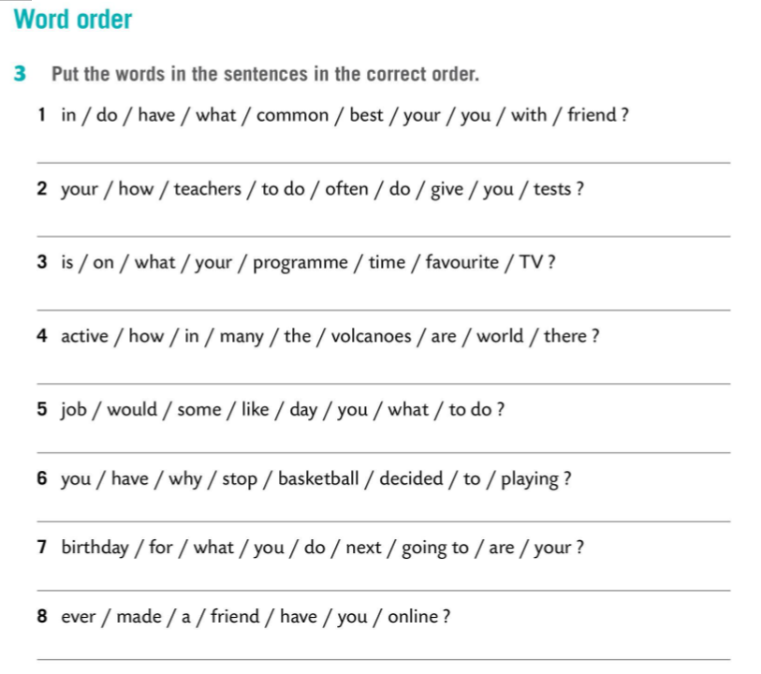
What do you have in common with your best friend?
How often do your teachers give you tests to do?
WORD ORDER
What time is your favourite programme on TV?
Wh-word (relative pronoun) + auxiliary verb + Subject + (the main) verb +...
How many active volcanoes are there in the world?
What job would you like to do some day?
Why have you decided to stop playing basketball?
What are you going to do for your next birthday?
Have you ever made an online friend?

Slide 4
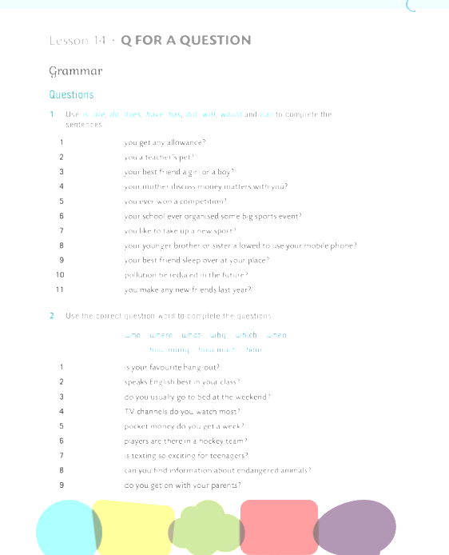
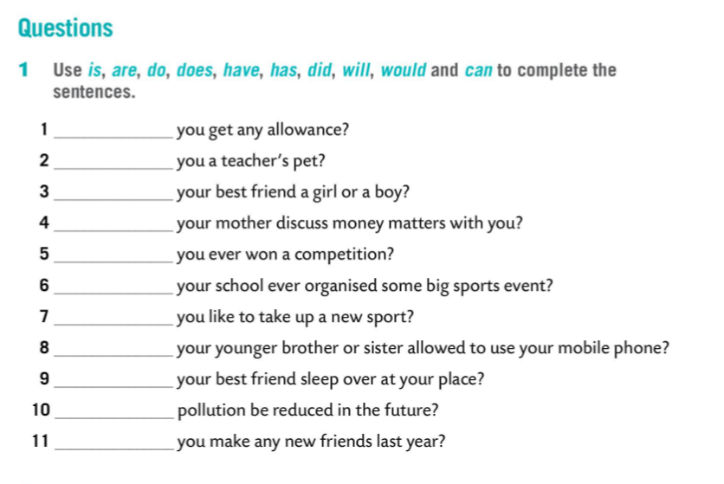
Do
Are
Is
Does
Have
Has
Would
Is
Does
Can
Did

Slide 5
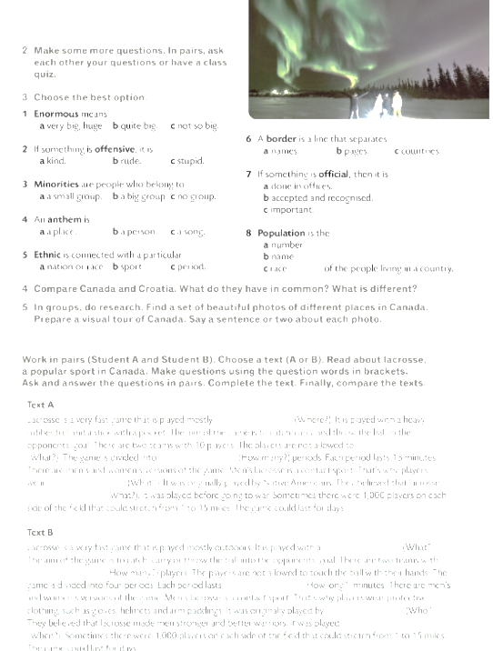
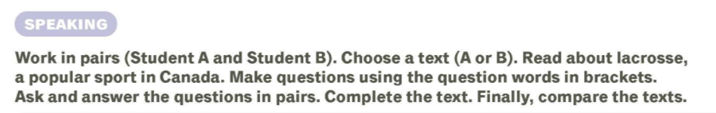
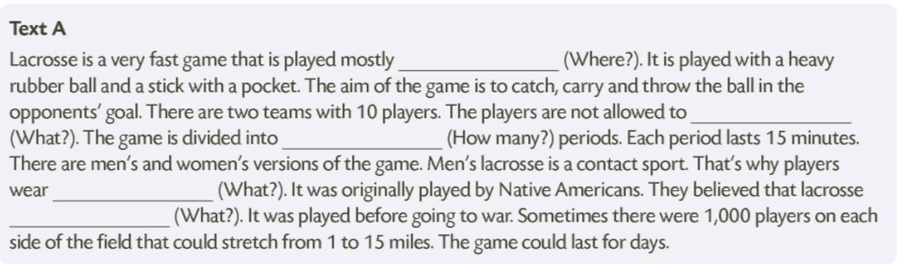
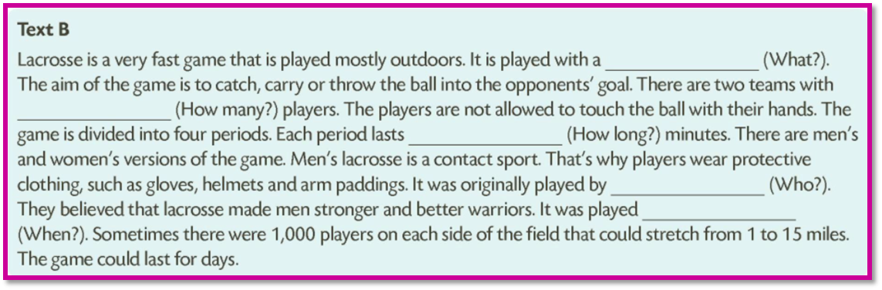

Slide 6
outdoors
touch the ball with their hands
four
protective clothing, such as gloves, helmets and arm paddings
made men stronger and better warriors
heavy rubber ball and a stick with a pocket
10
15
Native Americans
before going to war

Slide 7
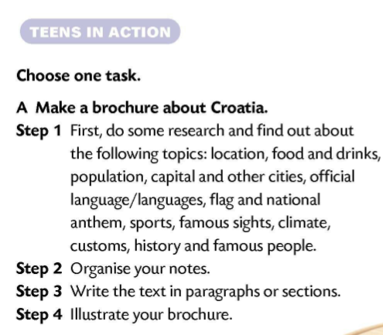
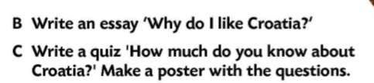
Comment on lacrosse by using the following beginnings:
I didn’t know...
I find it interesting that...
The funniest thing is...
What lacrosse has in common with ... is that...
Lacrosse is different from ... because...
Next, close your Class Books.
Now write a paragraph describing lacrosse.
Then open your books to check how you’ve done.

